Slide 1
To Save a Heart
Henry Oluka, Paul Parkin, Ryan Woodward
Notes:
Hi Everyone, Our names are….
We are group 6. Our project is To Save a Heart.

Slide 2
Purpose
Determine patterns within fatal and nonfatal heart attacks through research of heart diseases in order to prevent fatal heart attacks by helping physicians identify patterns well in advance of the event as well as helping patients identify if they need immediate attention
Notes:
Ryan - The purpose of our visualization project is to determine potential emergent patterns from fatal and nonfatal heart attacks. These patterns could help physicians recognize potential danger thresholds

Slide 3
Research Question
Can Selective and Associative data be interactively visualized to model the sequence of Interactive activities of a physician, during patient diagnosis?
Notes:
Read slides

Slide 4
Data
Cases: Patients
Dimensions: age, sex, chest pain type, resting blood pressure, serum cholesterol, fasting blood sugar, resting cardio graphic maximum heart rate achieved, exercise induced angina, old-peak, slope peak exercise, number of major vessels, and thal
303 cases X 14 dimensions
https://www.kaggle.com/ronitf/heart-disease-uci
Notes:
Paul Parkin
Angina - Low blood flow to heart muscles
Chest pain types - Anginal, atypical anginal, non-anginal, asymptomatic (no symptoms)
Old peak - Electrocardiograph depression below baseline for exercise
Thalassemia - low hemoglobin - inherited - Normal (uptake), fixed defect, reversible defect
Patients - No heart disease or varying levels

Slide 5
Data Questions
Are there emerging patterns for patients who experience cardiac issues at a younger age?
Are there warning signs that a cardiac arrest is imminent given the pain described and the underlying symptoms?
Is there a threshold at which a patient needs invasive surgery, or can surgery be avoided?
Notes:
Paul Parkin
4 age categories - compare variable in each category.
4 chest pain types compared to health variables
Variables are given a weight- stacked-check a threshold

Slide 6
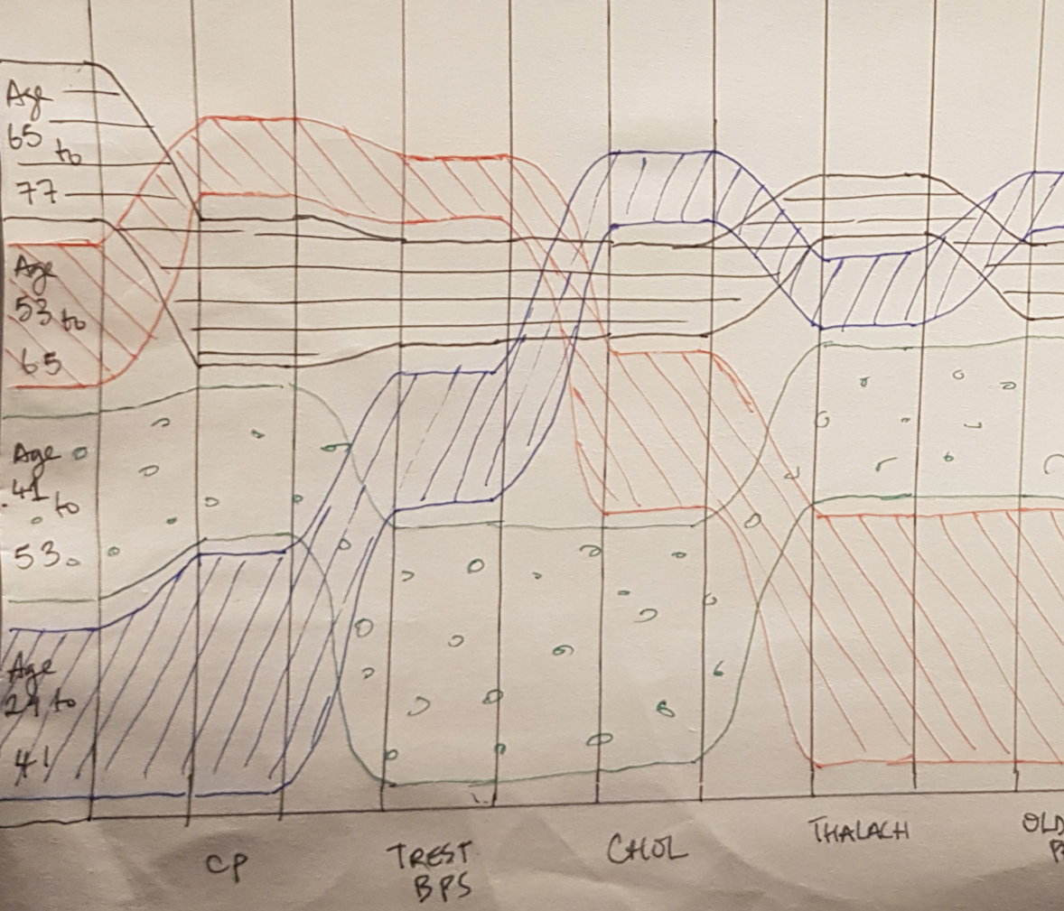
Sketch 1
Visualizing emerging patterns for patients using:
Age category, and
The value of each heart disease attribute in the dataset varies w.r.t age category.
Features
The x-axis
Presence of heart disease indicators.
The y-axis
age-categories from the dataset.
Ribbons:
Ribbon Size: case frequency for given attribute w.r.t age-category.
Ribbon Position: The ribbons are vertically sorted by size.
Notes:
Visualizing each heart disease attribute with respect to age category. The x-axis.. The y-axis...

Slide 7
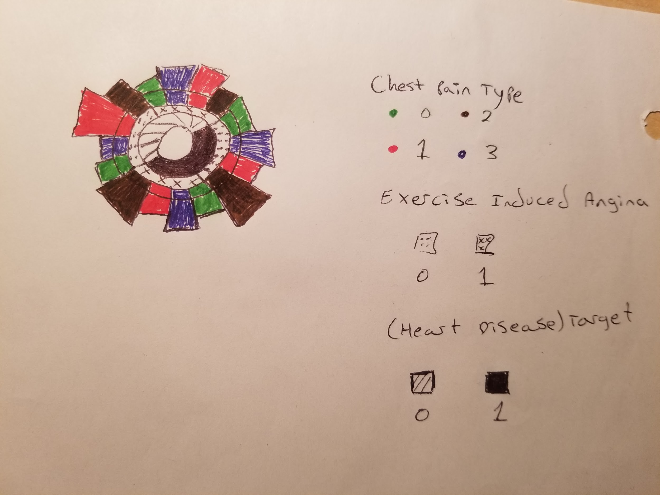
Sketch 2
Shows warning signs for a heart attack for each chest pain type
Color (Chest Pain Type)
Dots or x’s (Exercise Induced Angina)
Hatched or filled (Target - Heart Disease)
Length (Max. Heart Rate)
Notes:
Paul Parkin
Can create multiple graphs to see each health variable compared to chest pain, heart diseases, and exercise induced angina

Slide 8
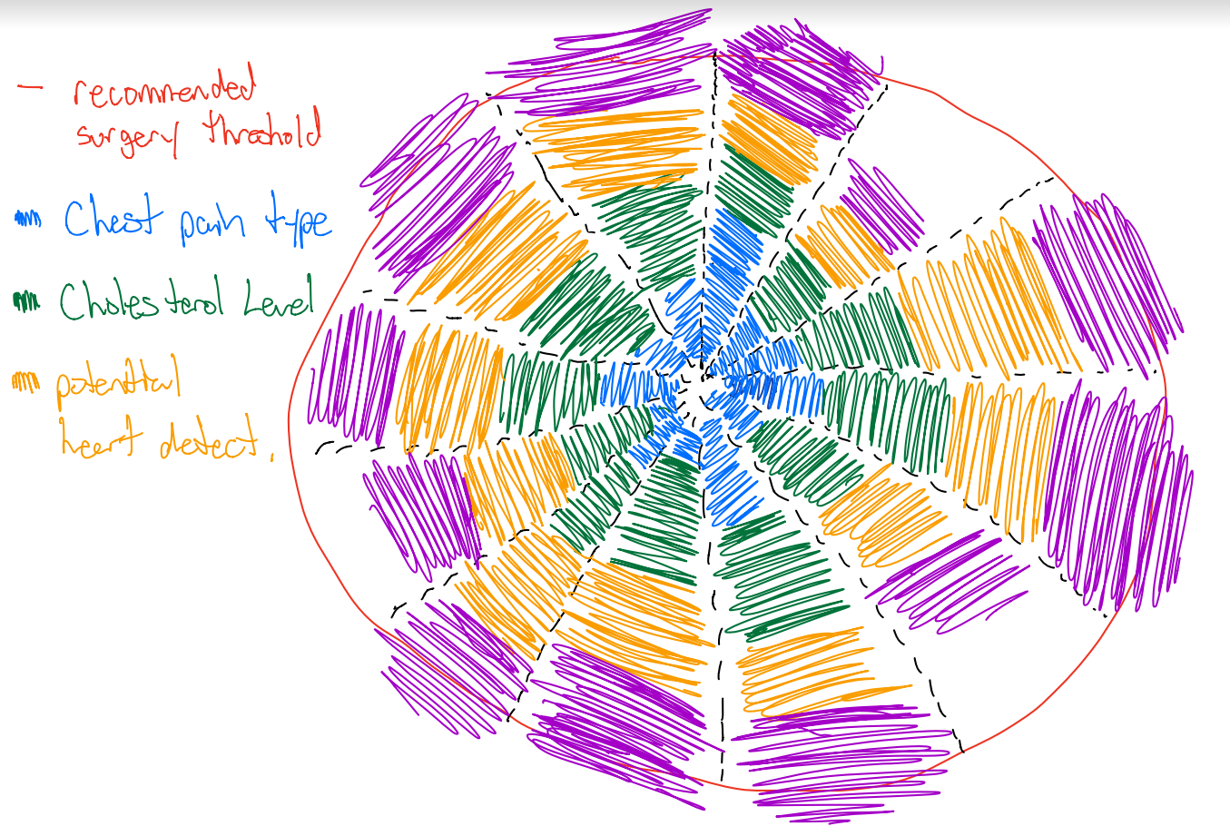
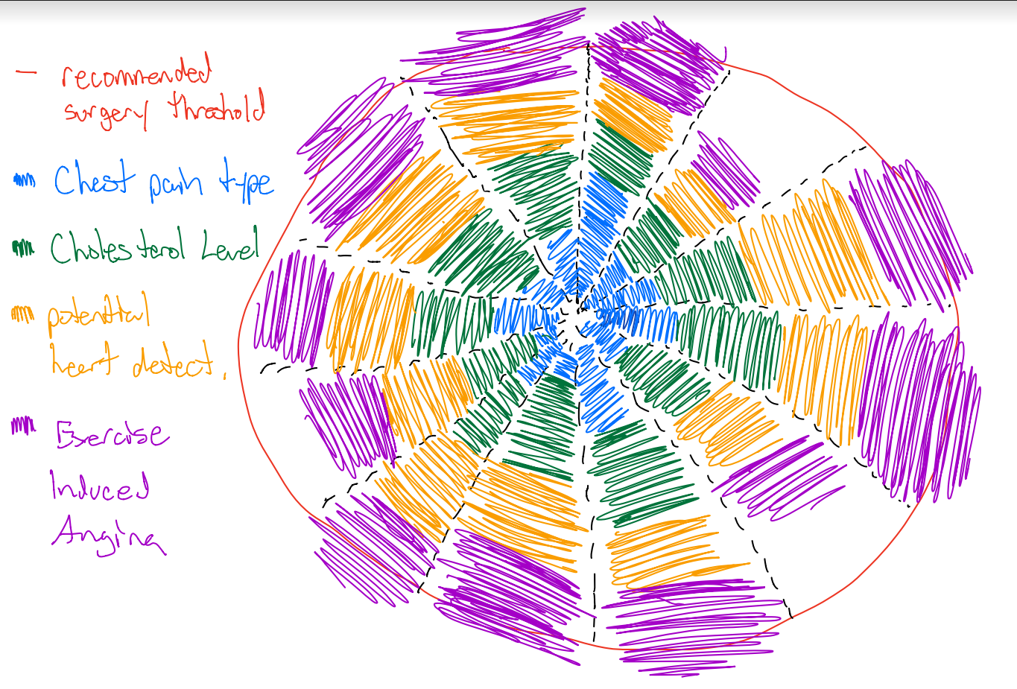
Sketch 3
Determines if potential surgery is needed by important correlated weights crossing the threshold
Important data dimensions are
Chest pain type
Cholesterol level
Potential Heart Defects
Exercise Induced Angina
Notes:
Ryan - This preliminary circular bar graph attempts to indicate whether or not a surgery could potentially be needed by incorporating a red surgery threshold line around several key data dimensions. If chest pain type, cholesterol level, heart defects, and exercise induced angina crosses a particular threshold then it would be indicative that a patient is under significant duress.

Slide 9
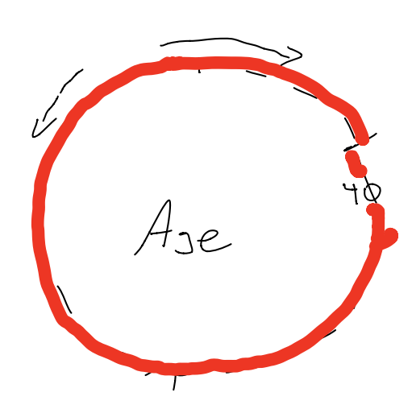
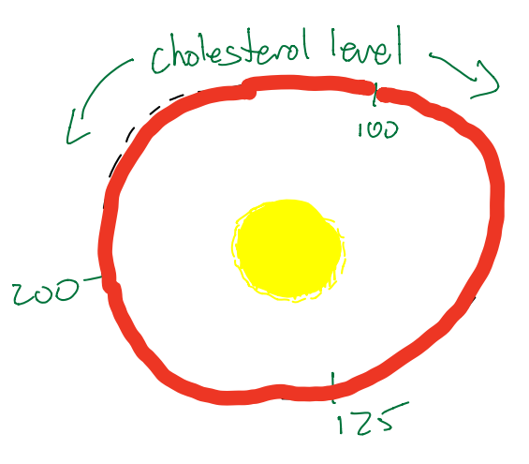
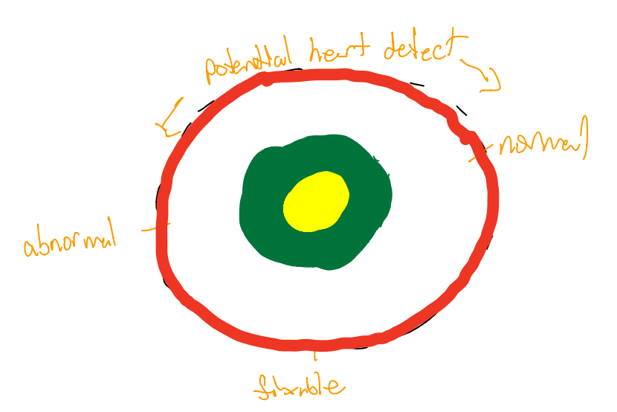
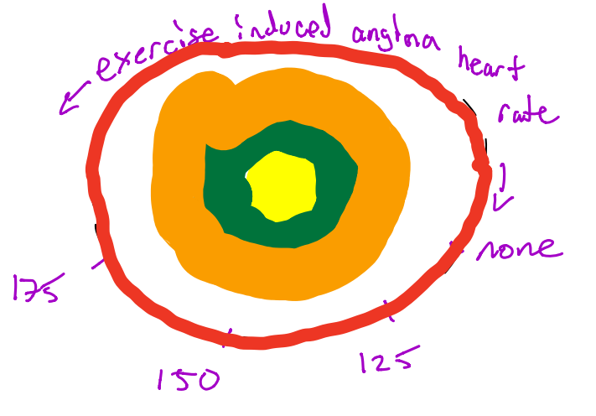
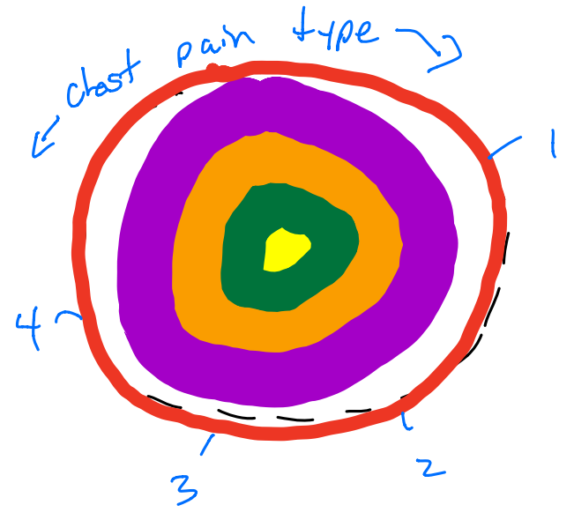
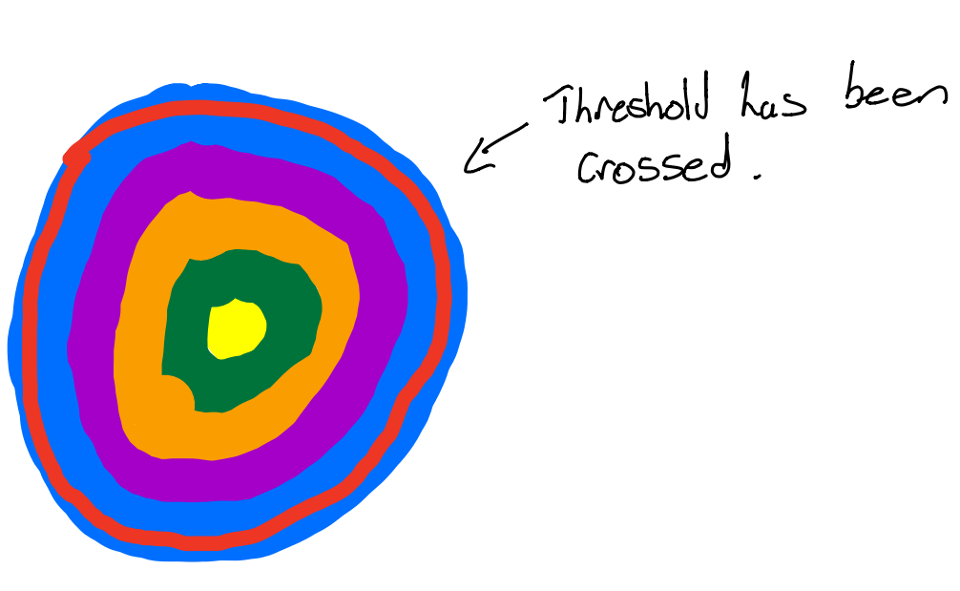
Proposed Solution
Notes:
Ryan - The proposed solution looks similar to the previous sketch however it would have an interactive element to it. Patients/doctors would be able to select values from the bar graph to be able to determine if a patient is about to cross a threshold. A more robust visualization is planned to incorporate designs from all 3 sketches that would allow multiple circular bar graphs to be connected using the most correlative data in order to use the visualization to predict potential problems.

Slide 10
Existing knowledge
Most relevant peer-reviewed attributes (from the dataset) that influences an individual’s propensity to have a cardiac episode are:
age
sex
chest pain type (4 values)
resting blood pressure
serum cholesterol in mg/dl
fasting blood sugar > 120 mg/dl
resting electrocardiographic results (values 0,1,2)
maximum heart rate achieved
exercise induced angina
oldpeak = ST depression induced by exercise relative to rest
the slope of the peak exercise ST segment
number of major vessels (0-3) colored by fluoroscopy
thal: 3 = normal; 6 = fixed defect; 7 = reversible defect
https://archive.ics.uci.edu/ml/datasets/Heart+Disease
Notes:
Here are some of the most relevant measurables from the cardiac arrest patient data dimensions from our dataset. They are peer-reviewed. They are the dimensions we’ll consider in our project.

Slide 11
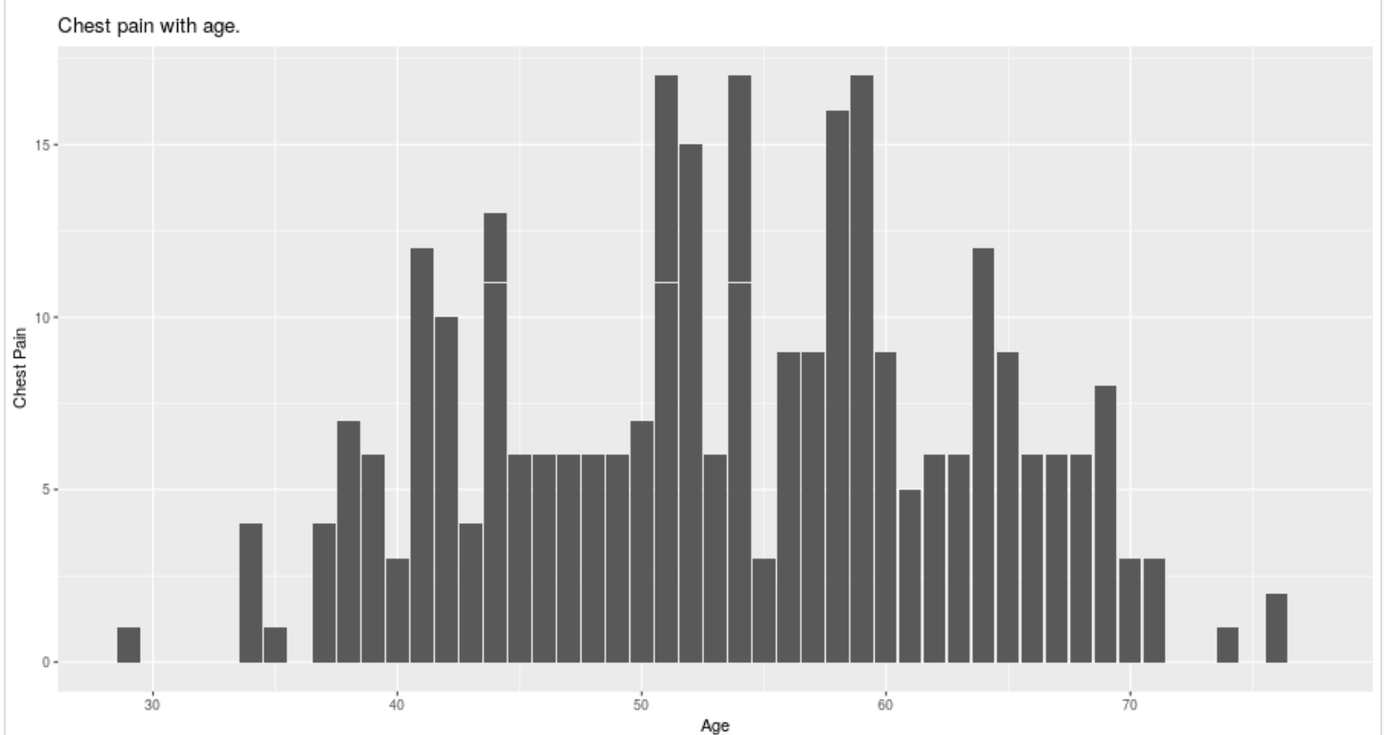
Related Work / Existing knowledge
Chest pain tends to peak between the ages of 50 and 60
Notes:
Ryan - We can see from this simply bar graph that chest pain severity tends to peak between 50-60 as well as in early 40s

Slide 12
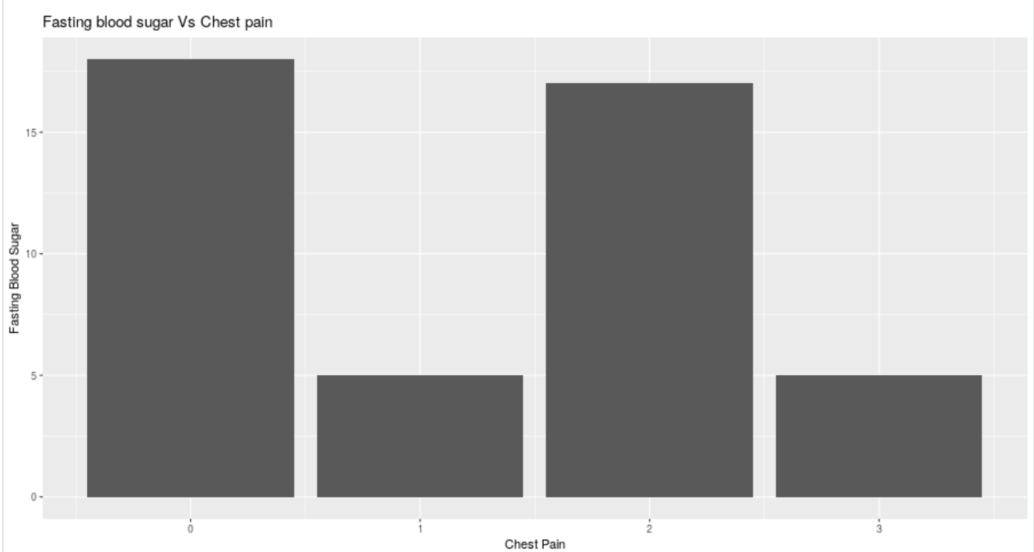
Related Work / Existing
knowledge
Fasting Blood Sugar has very little effect on patient’s pain report
Notes:
Ryan - We can also see from this bar graph that a patient’s fasting blood sugar doesn’t seem to correlate at all with a patient’s chest pain reports

Slide 13
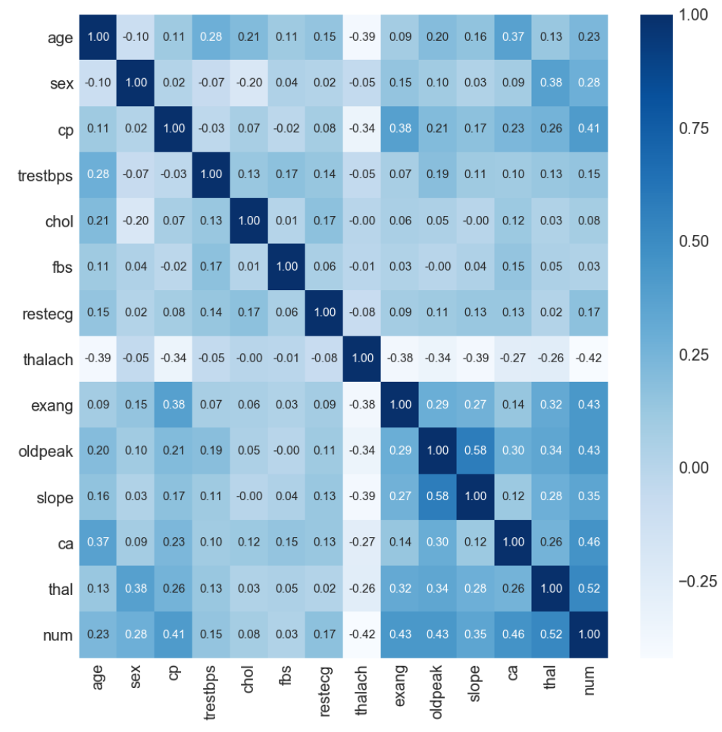
Related Work / Existing
knowledge
Data analysis in the form of a correlation matrix has been explored by Jae Duk Seo
https://towardsdatascience.com/basic-medical-data-exploration-visualization-heart-diseases-6ab12bc0a8b7
Notes:
Ryan - A correlation matrix has been explored by a data scientist named Jae Duk Seo. This gives us the ability to see which attributes have a stronger link to whether or not a cardiac has been fatal.

Slide 14
Related Work / Existing
knowledge
Strong correlations between
Heart Defects and predictable Heart Attacks
Exercise Induced Angina leading to Chest Pain and Heart Attacks
Notes:
Ryan - This matrix has indicated several strong correlations. This would be between whether or not a patient has a normal heart, a fixable defect, or an abnormal defect. Correlations also presented themselves when exercise induced angina led to chest pain and heart attacks. The exercise induced angina could be a key visualization attribute as it could indicate a danger threshold that patients could be well aware of. In this case a visualization could be key to inform patients that if their heart rate enters a particular beats per second, they could drastically increase their risk of having a cardiac arrest.

Slide 15
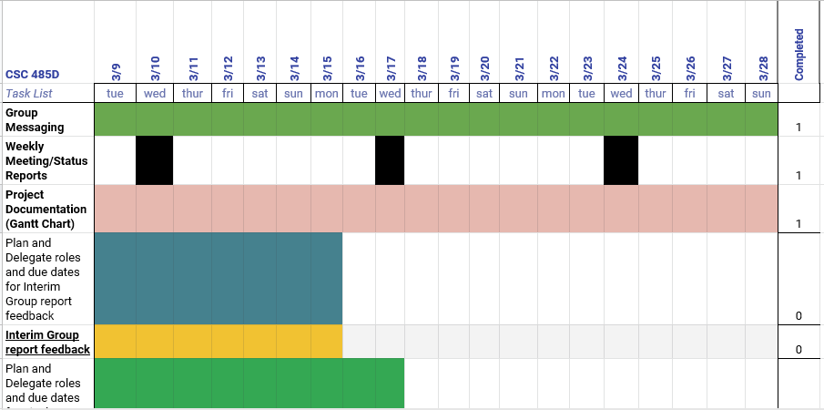
Gantt Chart
Notes:
We have created a gantt chart to be used in the planning of project tasks and sub-tasks.

Slide 16
Potential Risks
Poor management of deliverables
Mitigation:
Slack
Meetings
Poor team cohesion
Mitigation:
Documentation
Equal distribution of work
Notes:
Paul Parkin
Poor Management of deliverables: The team used a collaboration tool, Slack, to communicate and remind each other of pending tasks.
Weekly meetings were used for catch-up briefings.
Poor team cohesion: We mitigated this issue by communally delegating roles, documentation of project deliverables and creating a project charter of the team's vision and goals.

